Slide 1





MATHEMATICAL MODELLING OF STEM CELL DYNAMICS DURING POST-EMBRYONIC ORGAN GROWTH
Diana-Patricia Danciu
Institute of Applied Mathematics,
Heidelberg University, Germany
Anna Marciniak-Czochra
Lazaro Centanin
Karlovasi, 13.09.2019
MBMC 2019, University of the Aegean

Slide 2
Introduction
Biological background
Stem cells numbers
Organ growth and shape
Concluding remarks
MOTIVATION – ORGAN GROWTH
How do stem cells build and grow an organ?
How many stem cells? Difficult to count – stem cell markers, organ structure?
How do stem cells coordinate their division and activity to build the organ?
Applications in wound healing and organ regeneration
Fish adult stem cells ≈ mammalian embryonic stem cells or cancer stem cells

Slide 3
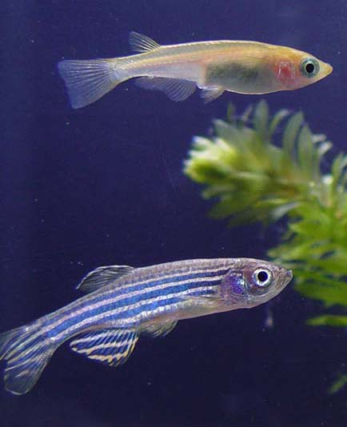
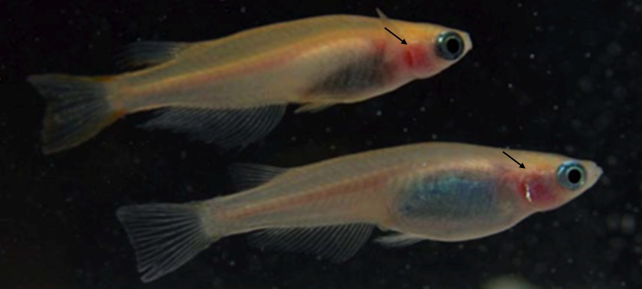
Introduction
Biological background
Stem cells numbers
Organ growth and shape
Concluding remarks
MODEL ORGANISM – MEDAKA FISH
Respiratory organ – branchia or gill
(Group of Lazaro Centanin, Heidelberg University)

Slide 4
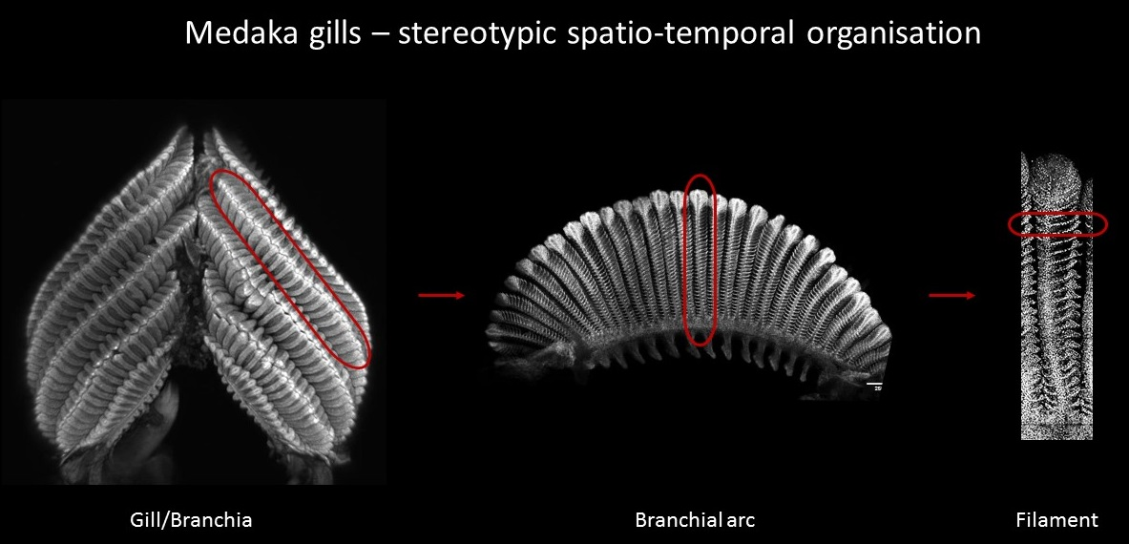
Introduction
Biological background
Stem cells numbers
Organ growth and shape
Concluding remarks
PROJECT DETAILS
Two approaches to understand development of the fish gill
Stochastic approach
Deterministic approach
How many stem cells are needed to build and maintain an organ?
What kind of heterogeneities exist among these stem cells?
What relations between different stem cells exist that give the organ its shape?
What other factors influence the proliferation of these stem cells?

Slide 5
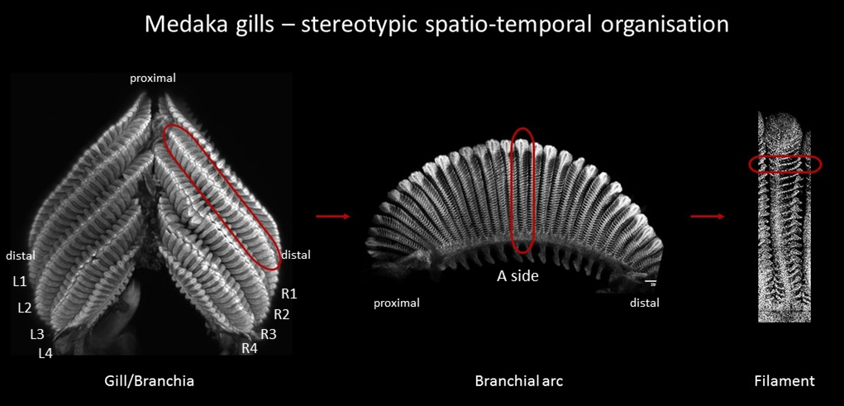
Introduction
Biological background
Stem cells numbers
Organ growth and shape
Concluding remarks
BIOLOGICAL BACKGROUND

Slide 6
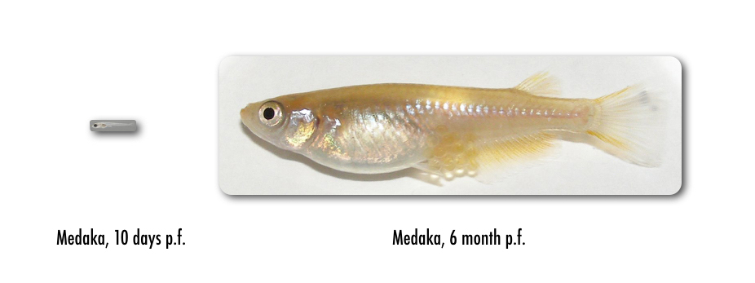

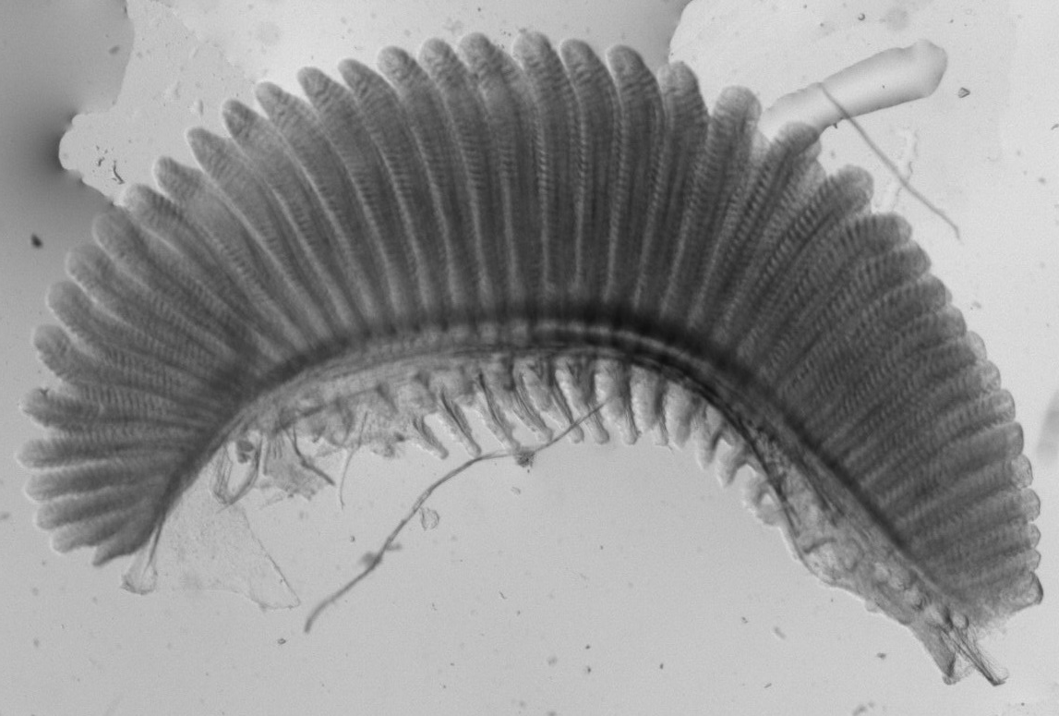
Introduction
Biological background
Stem cells numbers
Organ growth and shape
Concluding remarks
BIOLOGICAL BACKGROUND
Growth along two axes

Slide 7
Introduction
Biological background
Stem cells numbers
Organ growth and shape
Concluding remarks
BIOLOGICAL BACKGROUND
Growth along two axes
A

Slide 8
Introduction
Biological background
Stem cells numbers
Organ growth and shape
Concluding remarks
BIOLOGICAL BACKGROUND
Growth along two axes
A
A’
Addition of filaments

Slide 9
Introduction
Biological background
Stem cells numbers
Organ growth and shape
Concluding remarks
BIOLOGICAL BACKGROUND
Growth along two axes
A’
Elongation of filaments
A
Addition of filaments

Slide 10
Introduction
Biological background
Stem cells numbers
Organ growth and shape
Concluding remarks
BIOLOGICAL BACKGROUND
Growth along two axes
A’
A’’
Elongation of filaments
A
Addition of filaments

Slide 11
STEM CELL NUMBERS AND HETEROGENEITIES
  How many stem cells are needed to build and maintain the organ?
  What kind of heterogeneities exist among these stem cells?

Slide 12
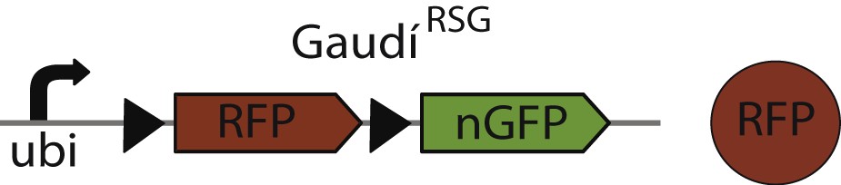

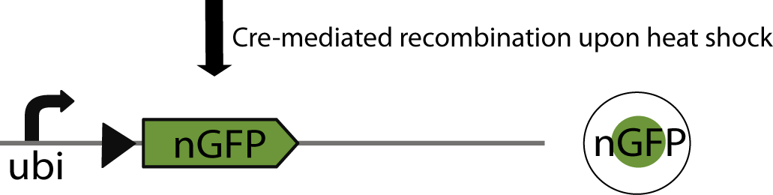



Introduction
Biological background
Stem cells numbers
Organ growth and shape
Concluding remarks
EXPERIMENTAL PROTOCOL AND DATA ACQUISITION
Cells labeled in embryonic stage
Label inherited by progeny
A

Slide 13
Introduction
Biological background
Stem cells numbers
Organ growth and shape
Concluding remarks
EXPERIMENTAL PROTOCOL AND DATA ACQUISITION
Cells labeled in embryonic stage
Label inherited by progeny
A

Slide 14
Introduction
Biological background
Stem cells numbers
Organ growth and shape
Concluding remarks
EXPERIMENTAL PROTOCOL AND DATA ACQUISITION
Cells labeled in embryonic stage
Label inherited by progeny
A₂
A₁
A₄
A₃
A₅
A₆
A₇
A₈
A

Slide 15
Introduction
Biological background
Stem cells numbers
Organ growth and shape
Concluding remarks
EXPERIMENTAL PROTOCOL AND DATA ACQUISITION
Cells labeled in embryonic stage
Label inherited by progeny
A
B
C

Slide 16
Introduction
Biological background
Stem cells numbers
Organ growth and shape
Concluding remarks
EXPERIMENTAL PROTOCOL AND DATA ACQUISITION
Cells labeled in embryonic stage
Label inherited by progeny
B₁
A₁
C₁
B₂
C₂
B₃
A₂
A₃
A
B
C

Slide 17
Introduction
Biological background
Stem cells numbers
Organ growth and shape
Concluding remarks
EXPERIMENTAL PROTOCOL AND DATA ACQUISITION
Cells labeled in embryonic stage
Label inherited by progeny
B₁
A₁
C₁
B₂
C₂
B₃
4 switches &
5 labelled filaments
A₂
A₃
A
B
C
1 | 1 | 0 | 1 | 1 | 0 | 0 | 1

Slide 18
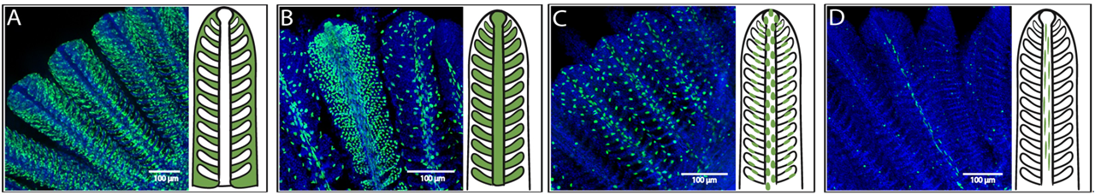
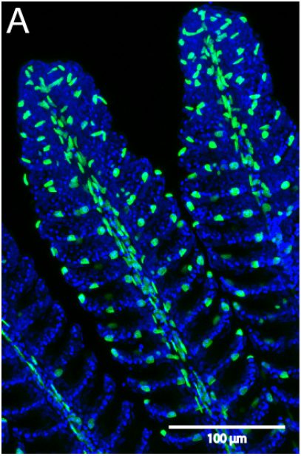
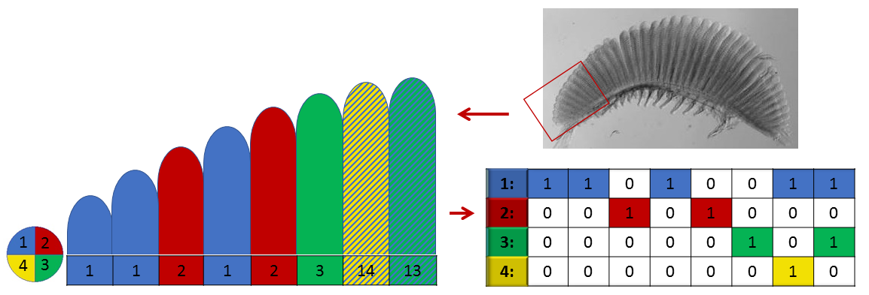
Introduction
Biological background
Stem cells numbers
Organ growth and shape
Concluding remarks
EXPERIMENTAL PROTOCOL AND DATA ACQUISITION
1
2
3
4
34
s=4, f=5
s=4, f=2
s=3, f=2
s=2, f=1

Slide 19
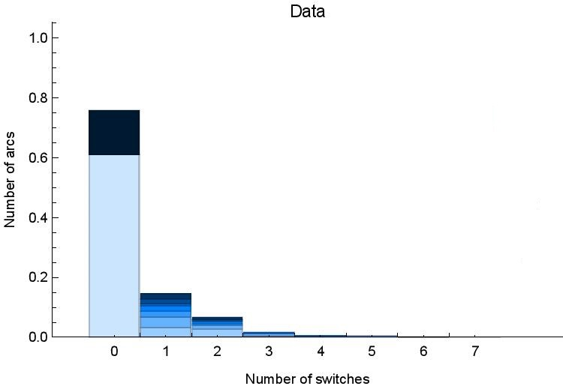
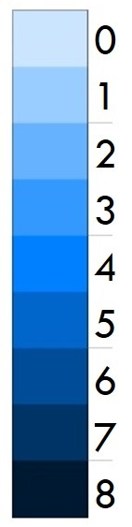
Introduction
Biological background
Stem cells numbers
Organ growth and shape
Concluding remarks
EXPERIMENTAL PROTOCOL AND DATA ACQUISITION
$$Labelling efficiency= \frac{Number of labelled oldest filaments}{Total number of arcs}$$

Slide 20
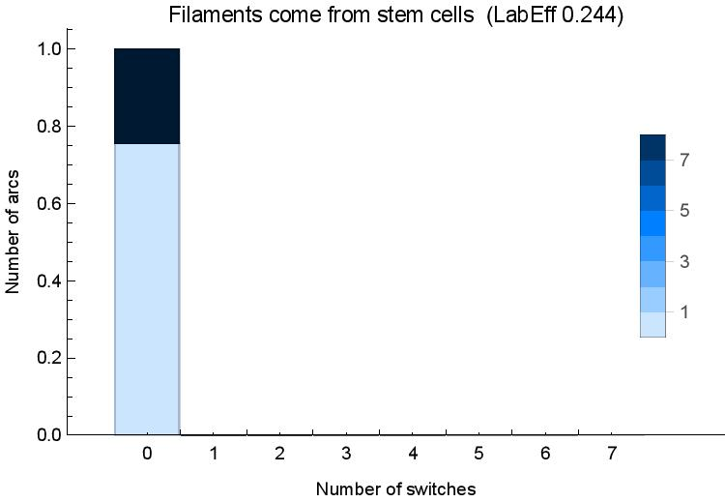
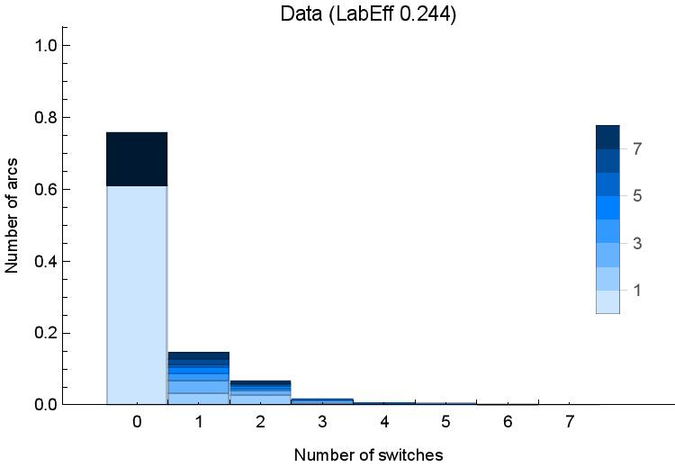
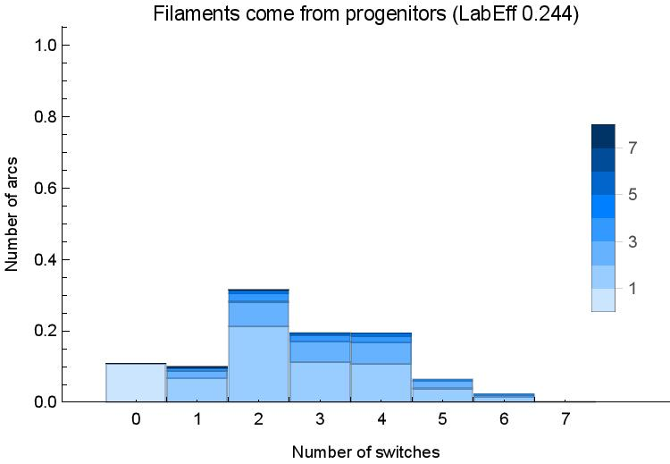
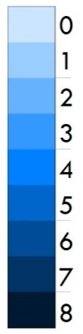
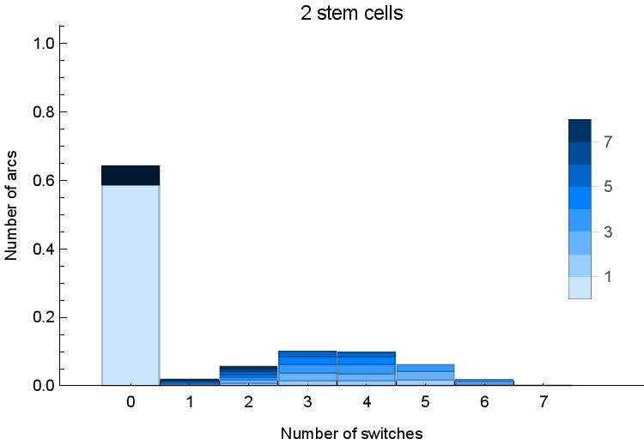
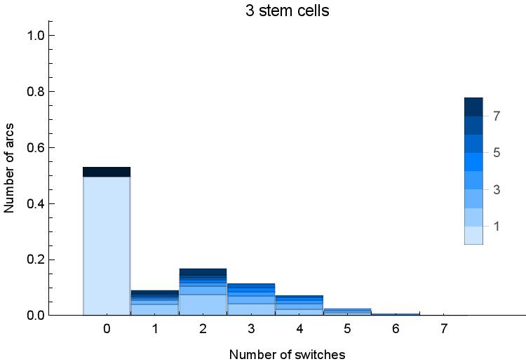
Introduction
Biological background
Stem cells numbers
Organ growth and shape
Concluding remarks
EXTREME SCENARIOS
Heterogeneous division behaviour
probDiv = probability of division
(Stolper et al., eLife, 2019)

Slide 21
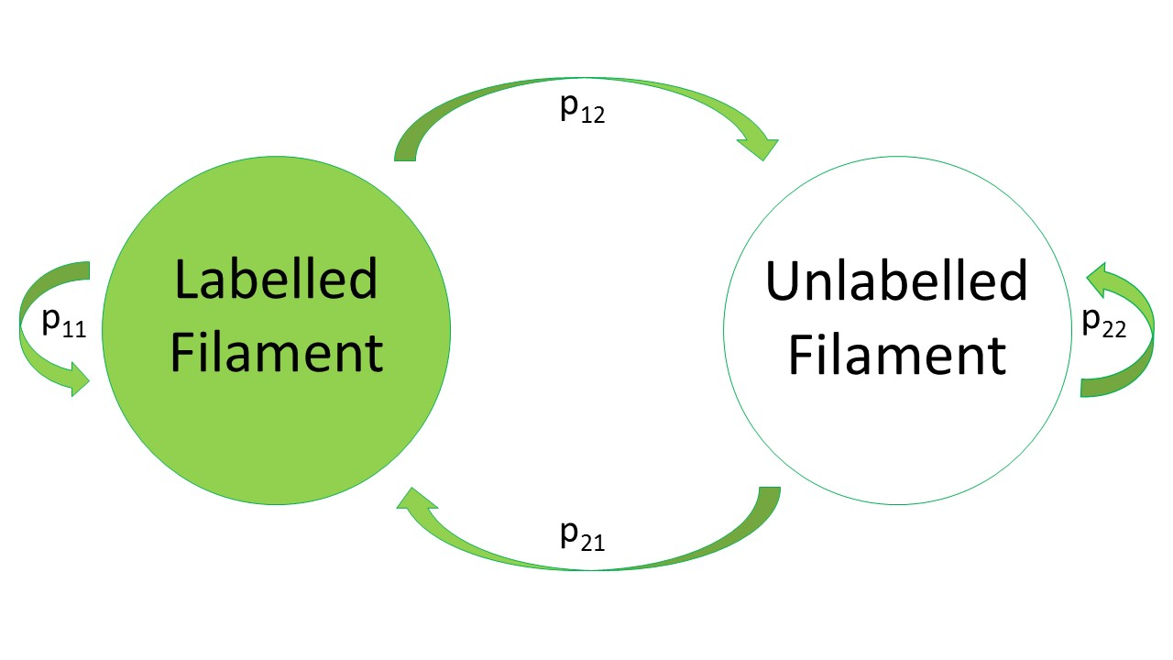
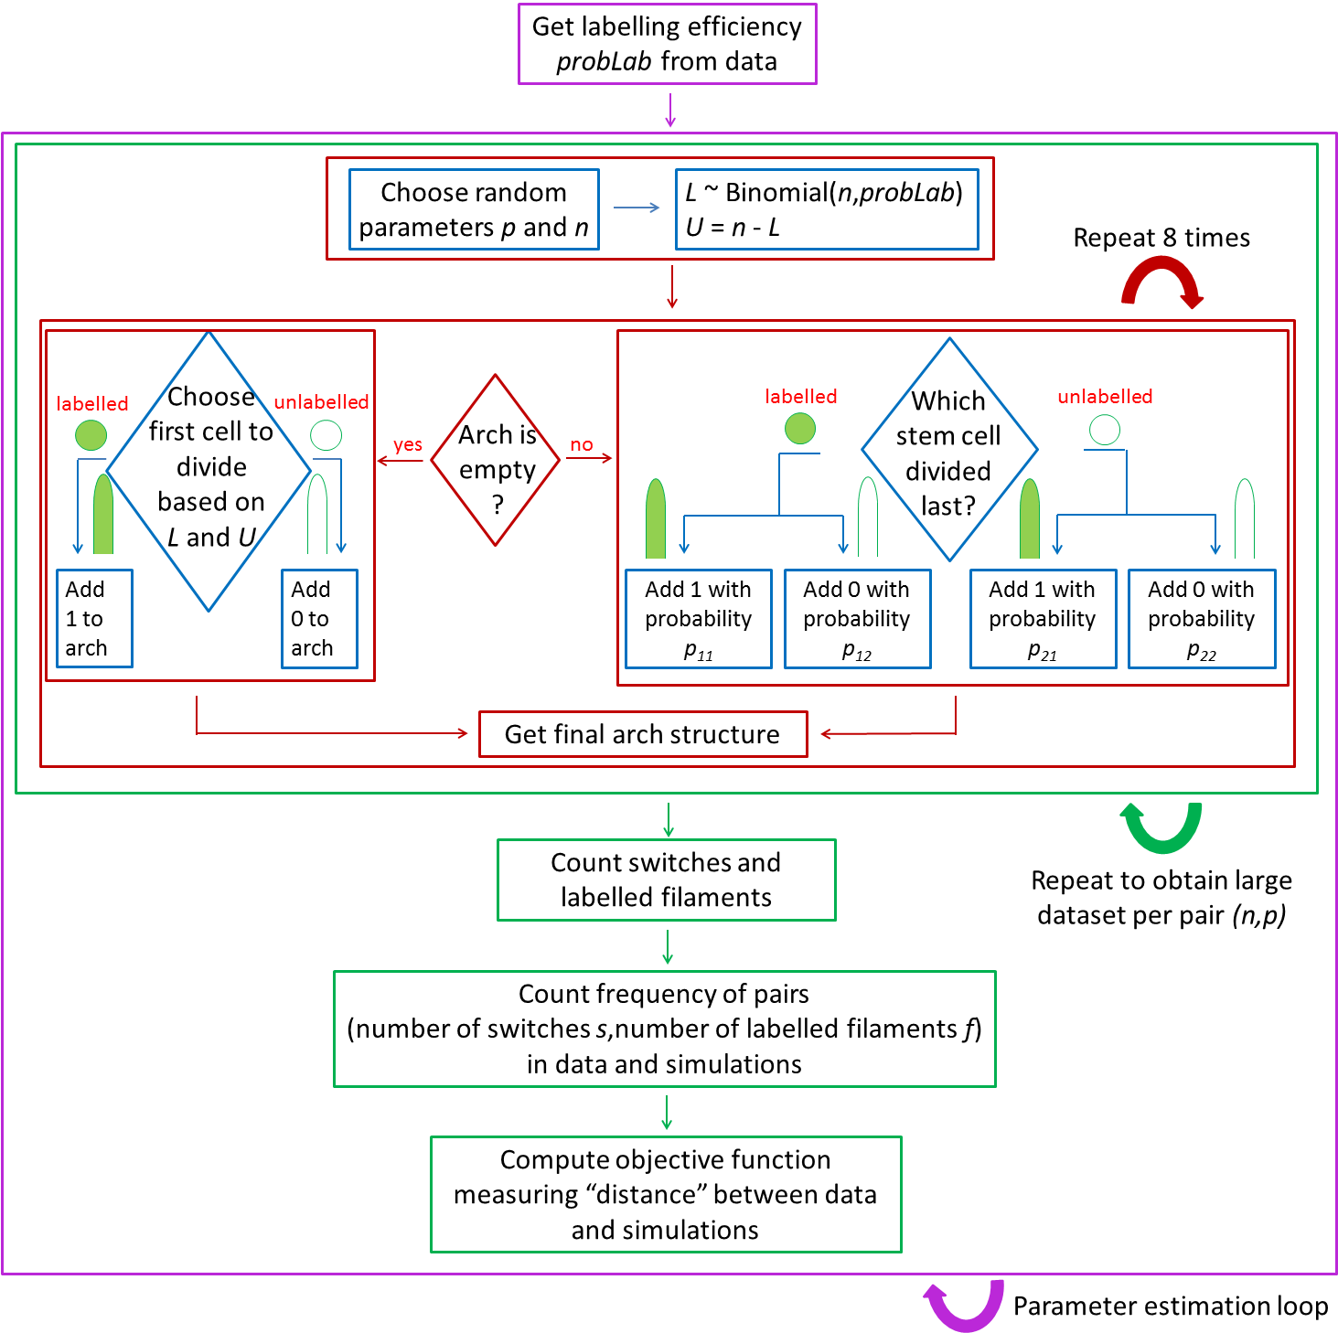
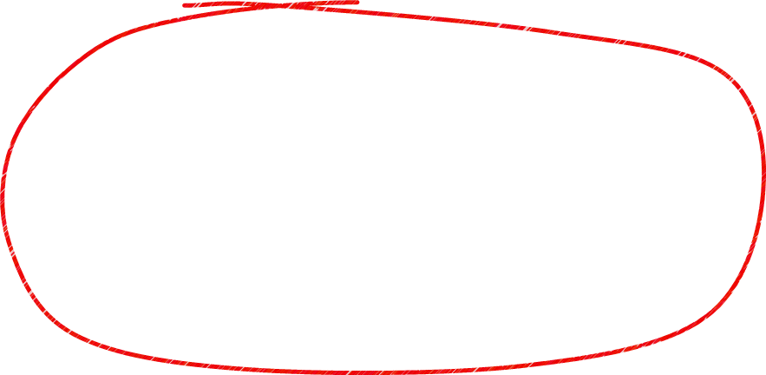
Introduction
Biological background
Stem cells numbers
Organ growth and shape
Concluding remarks
MATHEMATICAL APPROACHES
Markov Chains
Stochastic Simulations
One labelled stem cell (1) in the niche produces a labelled filament.
One unlabelled stem cell (0) gives rise to an unlabelled filament.
The number of labelled stem cells in the niche, L, depends on the labelling efficiency probLab and on the total number of stem cells in the niche n:
L ~ Binomial(n,probLab)
Therefore, the number of unlabelled stem cells, U=n-L.
The cell which has just divided will divide again with probability p.

Slide 22
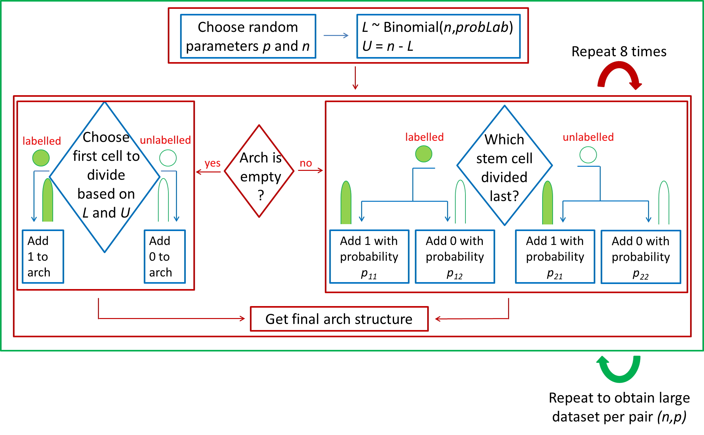
Introduction
Biological background
Stem cells numbers
Organ growth and shape
Concluding remarks
STOCHASTIC SIMULATIONS
Produce in silico branchial arches
Count switches and labelled filaments
Compute frequency of observing a pair (s,f) in the simulation results

Slide 23
Introduction
Biological background
Stem cells numbers
Organ growth and shape
Concluding remarks
MATHEMATICAL APPROACHES
Markov Chains
Stochastic Simulations
One labelled stem cell (1) in the niche produces a labelled filament.
One unlabelled stem cell (0) gives rise to an unlabelled filament.
The number of labelled stem cells in the niche, L, depends on the labelling efficiency probLab and on the total number of stem cells in the niche n:
L ~ Binomial(n,probLab)
Therefore, the number of unlabelled stem cells, U=n-L.
The cell which has just divided will divide again with probability p.

Slide 24
Introduction
Biological background
Stem cells numbers
Organ growth and shape
Concluding remarks
MARKOV CHAINS
Probability transition matrix
Initial distribution
Compute exact probabilities of observing a pair (s,f) in the simulation results
Can compute mean hitting times

Slide 25
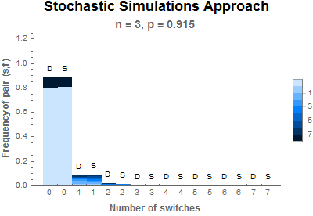
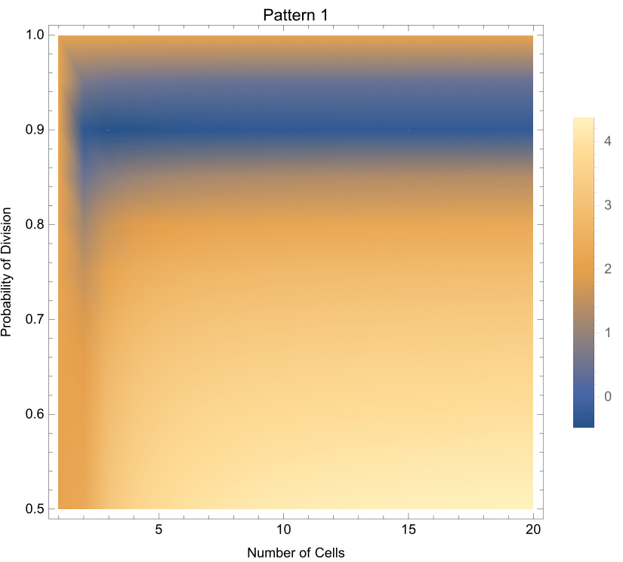
Introduction
Biological background
Stem cells numbers
Organ growth and shape
Concluding remarks
RESULTS
Log-
Objective function
Probability of Division
Number of stem cells

Slide 26
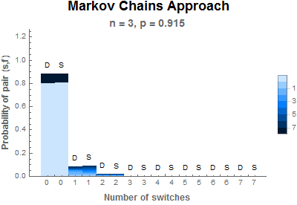
Introduction
Biological background
Stem cells numbers
Organ growth and shape
Concluding remarks
RESULTS
Few stem cells with a high probability of dividing again are needed in each niche for building the organ

Slide 27
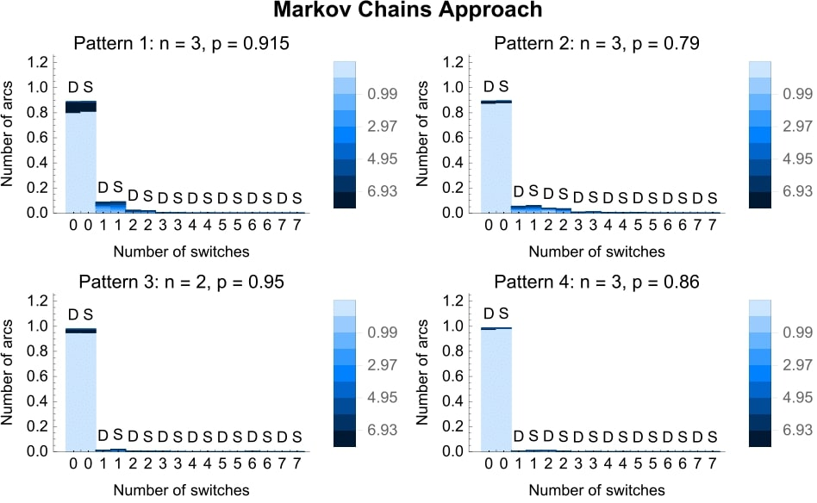
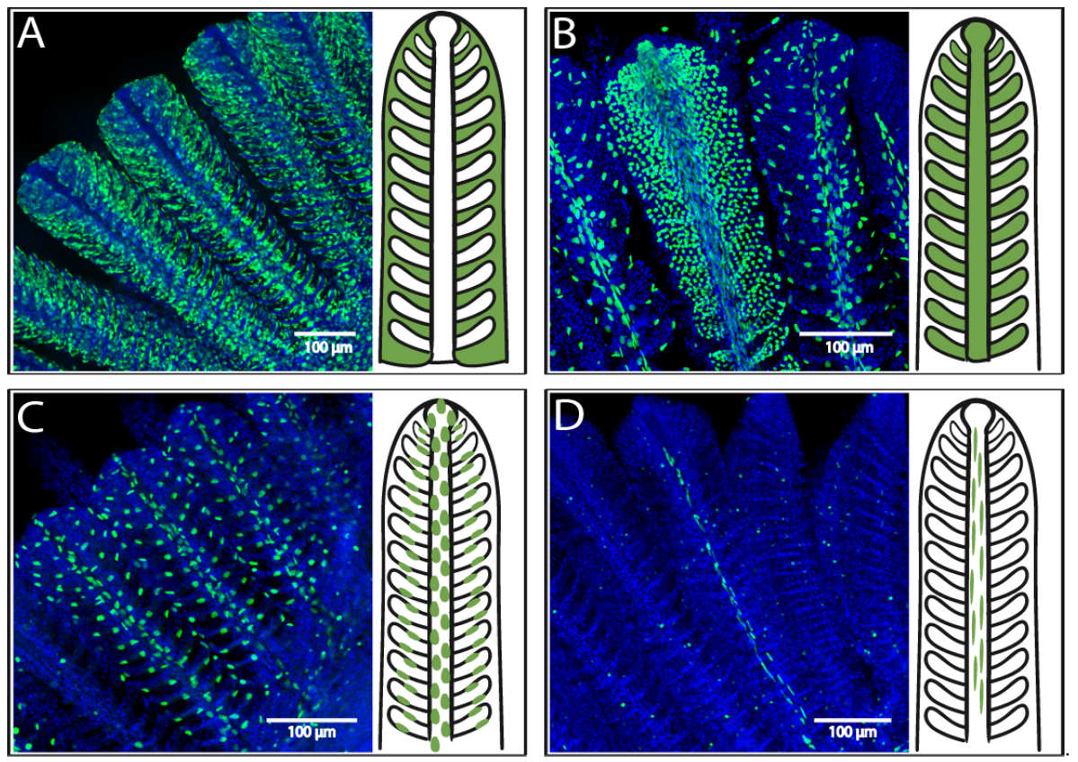
Introduction
Biological background
Stem cells numbers
Organ growth and shape
Concluding remarks
RESULTS
Four fate-restricted stem cell types in each niche
Few stem cells of each type with a high probability of dividing again are needed in each niche for building the organ

Slide 28
ORGAN GROWTH AND SHAPE
What relations between different stem cells exist that give the organ its shape?
What other factors influence the proliferation of these stem cells?

Slide 29
Introduction
Biological background
Stem cells numbers
Organ growth and shape
Concluding remarks
BIOLOGICAL BACKGROUND

Slide 30
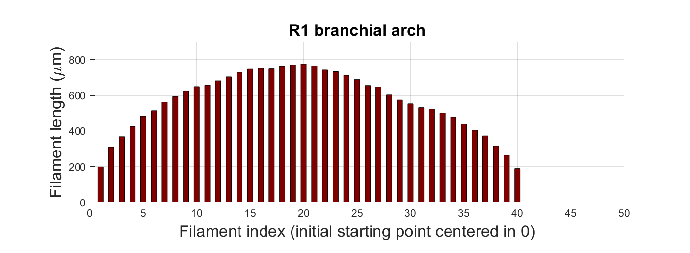
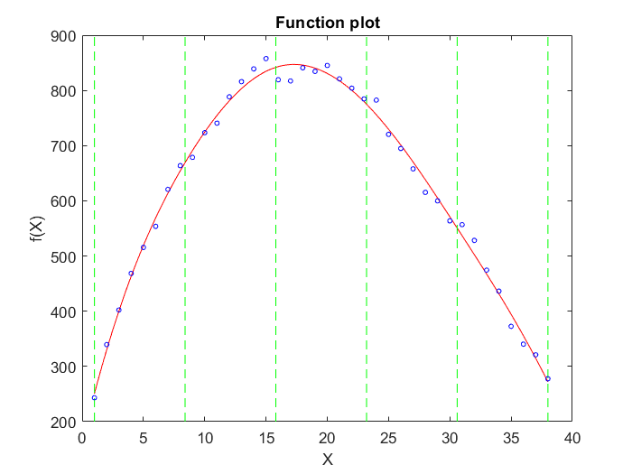
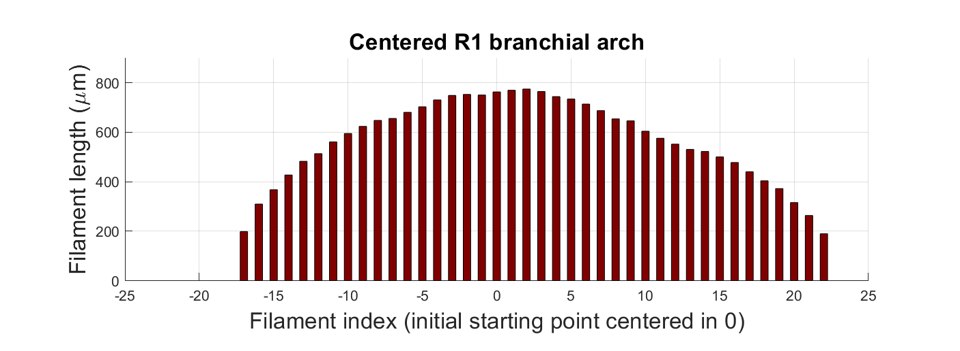
Introduction
Biological background
Stem cells numbers
Organ growth and shape
Concluding remarks
DATA TRANSFORMATION

Slide 31
Introduction
Biological background
Stem cells numbers
Organ growth and shape
Concluding remarks
DATA TRANSFORMATION
Niches move away from each-other with “velocities” given by proliferation rates
Filaments are added at times t_{i} when the niche reaches the position of the filament i.
Once filament i was added, it starts growing according to the function g.

Slide 32
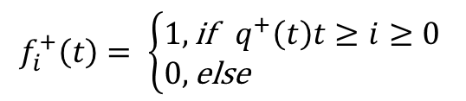
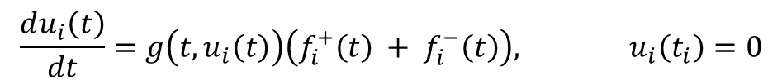

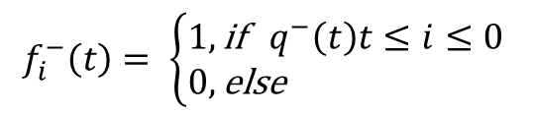
Introduction
Biological background
Stem cells numbers
Organ growth and shape
Concluding remarks
MATHEMATICAL MODEL
Change in length u of filament i
$$\frac{du_{i}\left(t\right)}{dt}=g\left(t,u_{i}\left(t\right)\right)\left(f_{i}^{+}\left(t\right) + f_{i}^{−}\left(t\right)\right), u_{i}\left(t_{i}\right)=0$$
Indicator functions for filament addition
$$f_{i}^{+}\left(t\right)= \left\{\begin{aligned}&1, \text{if} q^{+}\left(t\right)t≥i≥0 \\ &0, \text{else}\end{aligned}\right.$$
$$f_{i}^{−}\left(t\right)= \left\{\begin{aligned}&1, \text{if} { q}^{−}\left(t\right)t≤i≤0 \\ &0, \text{else}\end{aligned}\right.$$
“Velocities of niches”
$$q^{±}\left(t\right)$$
where
$$u_{i}:[t_{i},∞)→ℝ, i∈ℤ, f_{i}^{±}:[0,∞)→\{0,1\}, g:[t_{i},∞)×ℝ→ℝ, q^{±}:[t_{i},∞)→ℝ$$

Slide 33
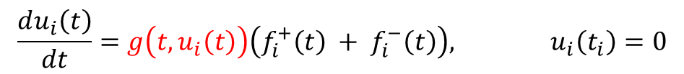
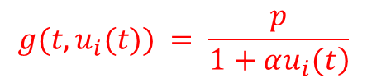
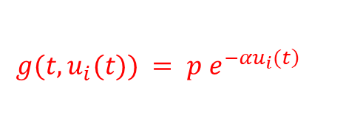
Introduction
Biological background
Stem cells numbers
Organ growth and shape
Concluding remarks
MATHEMATICAL MODEL
Change in length u of filament i
$$\frac{du_{i}\left(t\right)}{dt}=g\left(t,u_{i}\left(t\right)\right)\left(f_{i}^{+}\left(t\right) + f_{i}^{−}\left(t\right)\right), u_{i}\left(t_{i}\right)=0$$
Indicator functions for filament addition
$$f_{i}^{+}\left(t\right)= \left\{\begin{aligned}&1, \text{if} q^{+}\left(t\right)t≥i≥0 \\ &0, \text{else}\end{aligned}\right.$$
$$f_{i}^{−}\left(t\right)= \left\{\begin{aligned}&1, \text{if} { q}^{−}\left(t\right)t≤i≤0 \\ &0, \text{else}\end{aligned}\right.$$
“Velocities of niches”
$$q^{±}\left(t\right)$$
where
$$u_{i}:[t_{i},∞)→ℝ, i∈ℤ, f_{i}^{±}:[0,∞)→\{0,1\}, g:[t_{i},∞)×ℝ→ℝ, q^{±}:[t_{i},∞)→ℝ$$
Exponential decay models:
$$g(t,u_{i}(t)) = p e^{\left.−αu_{i}(t\right)}$$
Negative feedback models:
$$g(t,u_{i}(t)) = \frac{p}{\left.1+αu_{i}(t\right)}$$

Slide 34
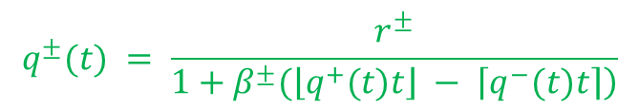
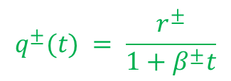


Introduction
Biological background
Stem cells numbers
Organ growth and shape
Concluding remarks
MATHEMATICAL MODEL
Change in length u of filament i
$$\frac{du_{i}\left(t\right)}{dt}=g\left(t,u_{i}\left(t\right)\right)\left(f_{i}^{+}\left(t\right) + f_{i}^{−}\left(t\right)\right), u_{i}\left(t_{i}\right)=0$$
Indicator functions for filament addition
$$f_{i}^{+}\left(t\right)= \left\{\begin{aligned}&1, \text{if} q^{+}\left(t\right)t≥i≥0 \\ &0, \text{else}\end{aligned}\right.$$
$$f_{i}^{−}\left(t\right)= \left\{\begin{aligned}&1, \text{if} { q}^{−}\left(t\right)t≤i≤0 \\ &0, \text{else}\end{aligned}\right.$$
“Velocities of niches”
$$q^{±}\left(t\right)$$
where
$$u_{i}:[t_{i},∞)→ℝ, i∈ℤ, f_{i}^{±}:[0,∞)→\{0,1\}, g:[t_{i},∞)×ℝ→ℝ, q^{±}:[t_{i},∞)→ℝ$$
$$q^{±}(t) = \frac{r^{±}}{1+β^{±}t}$$
Exponential decay models:
$$g(t,u_{i}(t)) = p e^{\left.−αu_{i}(t\right)}$$
with
$$g(t,u_{i}(t)) = \frac{p}{\left.1+αu_{i}(t\right)}$$
$$q^{±}(t) = \frac{r^{±}}{\left.1+β^{±}(\left\lfloor q^{+}(t)t\right\rfloor − \left\lceil q^{−}(t)t\right\rceil \right)}$$
Negative feedback models:
$$p>0, α,β^{±}≥0, r^{+}>0, r^{−}<0$$

Slide 35
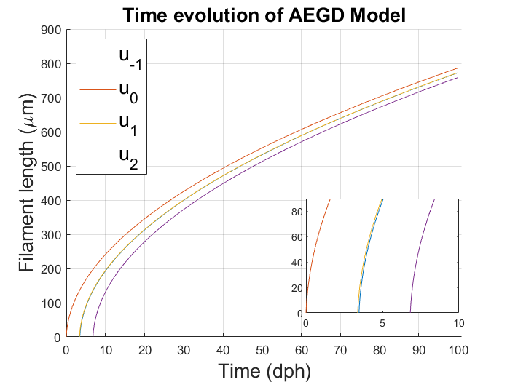
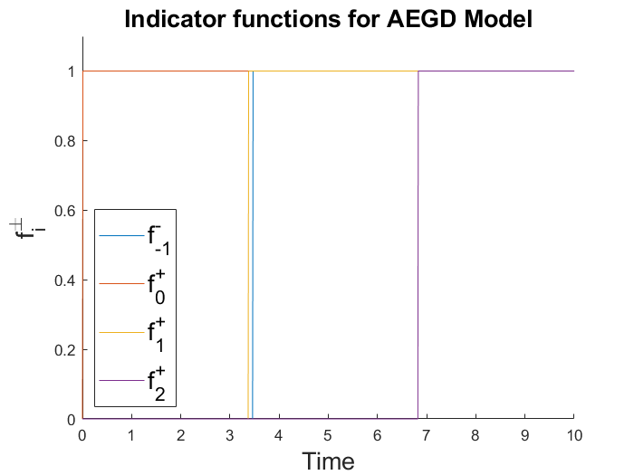
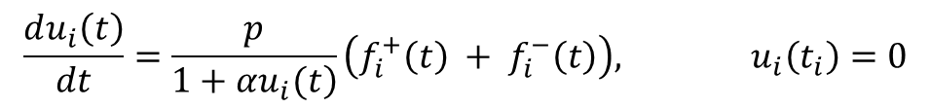

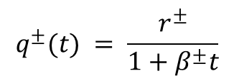


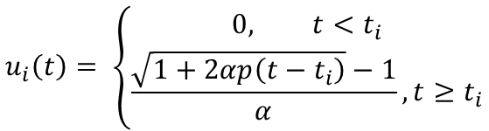
Introduction
Biological background
Stem cells numbers
Organ growth and shape
Concluding remarks
MATHEMATICAL MODEL
Change in length u of filament i
$$\frac{du_{i}\left(t\right)}{dt}=\frac{p}{\left.1+αu_{i}(t\right)}\left(f_{i}^{+}\left(t\right) + f_{i}^{−}\left(t\right)\right), u_{i}\left(t_{i}\right)=0$$
Indicator functions for filament addition
$$f_{i}^{+}\left(t\right)= \left\{\begin{aligned}&1, \text{if} q^{+}\left(t\right)t≥i≥0 \\ &0, \text{else}\end{aligned}\right.$$
$$f_{i}^{−}\left(t\right)= \left\{\begin{aligned}&1, \text{if} { q}^{−}\left(t\right)t≤i≤0 \\ &0, \text{else}\end{aligned}\right.$$
$$q^{±}(t) = \frac{r^{±}}{1+β^{±}t}$$
“Velocities of niches”
Solution
$$u_{i}\left(t\right)= \left\{\begin{aligned}0, t<t_{i} \\ \frac{\sqrt{1+2αp\left(t−t_{i}\right)}−1}{α}, t≥t_{i}\end{aligned}\right.$$
$$[0,∞)$$
Positivity
Existence
Uniqueness
Regularity
$$u_{i}:[t_{i},∞)→ℝ$$
$$t_{i}=\frac{i}{r^{±}−iβ^{±}}$$

Slide 36
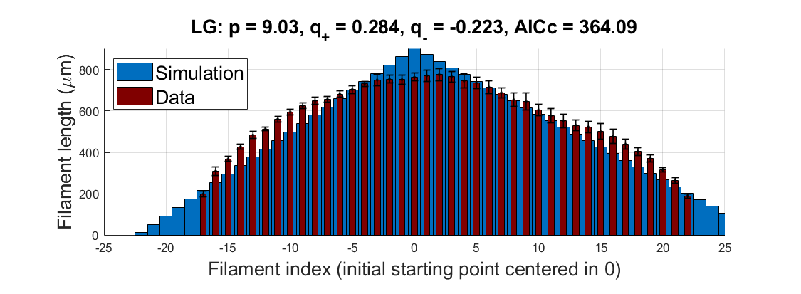
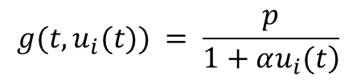
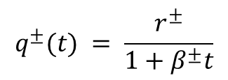
Introduction
Biological background
Stem cells numbers
Organ growth and shape
Concluding remarks
LINEAR-GROWTH MODEL
$$g(t,u_{i}(t)) = \frac{p}{\left.1+αu_{i}(t\right)}$$
$$q^{±}(t) = \frac{r^{±}}{1+β^{±}t}$$
$$p>0, α=0, β^{±}=0, r^{+}>0, r^{−}<0$$
Constant growth
Constant addition

Slide 37
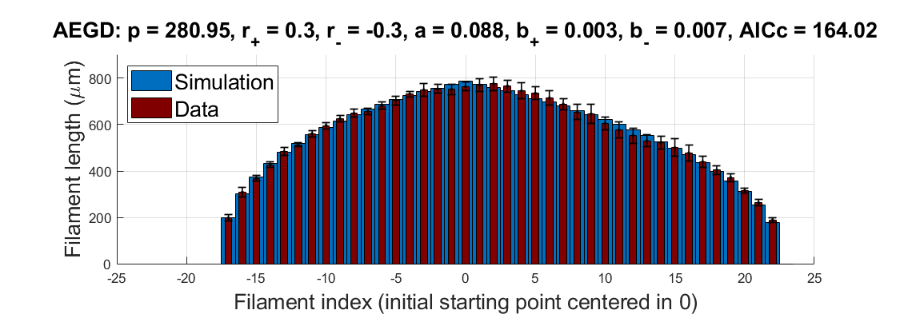
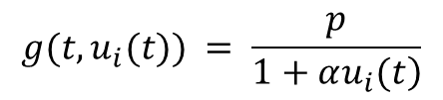
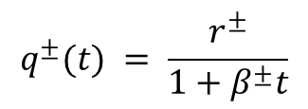
Introduction
Biological background
Stem cells numbers
Organ growth and shape
Concluding remarks
ALTERNATIVE ELONGATION-GENERATION DECAY MODEL (AEGD)
$$g(t,u_{i}(t)) = \frac{p}{\left.1+αu_{i}(t\right)}$$
$$q^{±}(t) = \frac{r^{±}}{1+β^{±}t}$$
$$p>0, α>0, β^{±}>0, r^{+}>0, r^{−}<0$$
Decaying growth with length of filaments
Decaying addition with time/age

Slide 38





Introduction
Biological background
Stem cells numbers
Organ growth and shape
Concluding remarks
SPACE-DEPENDENT ELONGATION-GENERATION-DECAY MODEL (SAEGD)
$$g(t,u_{i}(t)) = \frac{p}{\left.1+αu_{i}(t\right)}$$
$$q^{±}(t) = \frac{r^{±}}{\left.1+β^{±}(\left\lfloor q^{+}(t)t\right\rfloor − \left\lceil q^{−}(t)t\right\rceil \right)}$$
$$p>0, α>0, β^{±}>0, r^{+}>0, r^{−}<0$$
AICc = 245.13
Decaying growth with length of filaments
Decaying addition with total number of filaments

Slide 39




Introduction
Biological background
Stem cells numbers
Organ growth and shape
Concluding remarks
RESULTS
AEGD: F5R4
AEGD: F7R2
SAEGD: F5R4
SAEGD: F7R2

Slide 40




Introduction
Biological background
Stem cells numbers
Organ growth and shape
Concluding remarks
RESULTS
Decay in proliferation of both fil. generating- and fil. elongating-stem cells (AEGD model)
$$\frac{p}{α}$$
Indication of approximate length of oldest filament
Measure of the symmetry around oldest filament
Control on the curvature of the half-arches
$$\frac{r^{+}}{r^{−}}∙\frac{1+β^{−}}{1+β^{+}}$$
$$β^{±}$$

Slide 41
Introduction
Biological background
Stem cells numbers
Organ growth and shape
Concluding remarks
CONCLUDING REMARKS
Few functionally heterogeneous stem cells in peripheral niches are needed for building the organ – activation/quiescence phases
Both stem cell types slow down their proliferation due to ageing, nutrient insufficiency or signaling cues

Slide 42
Introduction
Biological background
Stem cells numbers
Organ growth and shape
Concluding remarks
OUTLOOK
Cell type specific markers?
Coordination between cell types?
Why have big and small arches? Space constraints?
Time series data for better validation?
Gill cells marker?

Slide 43
Introduction
Biological background
Stem cells numbers
Organ growth and shape
Concluding remarks
THANK YOU FOR YOUR ATTENTION!
Few heterogeneous stem cells in each niche are needed for building the organ – activation/quiescence phases
Both stem cell types slow down their proliferation due to ageing or signaling cues
Karlovasi, 13.09.2019
MBMC 2019, University of the Aegean

Slide 44




Slide 45


Introduction
Biological background
Stem cells numbers
Organ growth and shape
Concluding remarks
ELONGATION-DECAY MODEL
$$q^{±}(t) = \frac{r^{±}}{1+β^{±}t}$$
$$g(t,u_{i}(t)) = p e^{\left.−αu_{i}(t\right)}$$
$$p>0, α>0, β^{±}=0, r^{+}>0, r^{−}<0$$
Decaying growth with length of filaments
Constant addition

Slide 46

Introduction
Biological background
Stem cells numbers
Organ growth and shape
Concluding remarks
ELONGATION-GENERATION-DECAY MODEL
$$q^{±}(t) = \frac{r^{±}}{1+β^{±}t}$$
$$g(t,u_{i}(t)) = p e^{\left.−αu_{i}(t\right)}$$
$$p>0, α>0, β^{±}>0, r^{+}>0, r^{−}<0$$
Decaying growth with length of filaments
Decaying addition with time/age

Slide 47



Slide 48



Slide 49


Slide 50
Introduction
Biological background
Stem cells numbers
Organ growth and shape
Concluding remarks
THANK YOU FOR YOUR ATTENTION!
Anna Marciniak-Czochra
Lazaro Centanin
Few functionally heterogeneous stem cells of each fate in the niche
Decay in proliferation along two axes
Karlovasi, 13.09.2019
MBMC, University of the Aegean

